Slide 1







AI Mental Health Chatbot
Team Members: Antariksh Ramesh,
Jaganath Selvan,
Prithviraju Venkataraman
IS 699 – Information Systems Project
Instructor: Abraham Asher

Slide 2


.
Introduction
Why This Project Matters:
Growing Mental Health Crisis:
1 in 5 adults in the U.S. experiences a mental health issue each year.
75% of young adults report struggling with anxiety or depression.
2. Access Challenges:
50% of people with mental health issues do not receive adequate support due to cost, stigma, or lack of availability.
Post-COVID-19, demand for mental health services has increased by 30%.

Slide 3
Objectives and Goals
Real-Time Emotional Assistance:
Create a scalable, 24/7 support tool that operates without human intervention.
Immediate support for users in distress.
Mood Tracking:
Personalized Recommendations:
Ensure the chatbot is accessible, empathetic, and responsive to user needs.
Logs and analyzes user moods.
Tailored mental health resources and coping strategies.

Slide 4

Business Case
& Market Opportunity
Growing Demand:
Target Audience:
Market Gap:
Mental health issues have significantly increased post-COVID-19.
Traditional support systems are often costly or inaccessible.
Students: Facing academic pressure and social challenges.
Young Adults: Managing early career stress and life transitions.
Corporate Wellness Programs: Companies seeking to support employee well-being
Limited availability of affordable and immediate mental health support.
Need for a 24/7, scalable solution that provides consistent care

Slide 5
Key Features and Benefits
Feature | Description
Mood Tracking | Logs user emotions and tracks mood changes over time.
Real-Time Emotional Support | Provides instant, AI-powered responses during user interactions.
Personalized Recommendations | Offers tailored resources like articles, exercises, and coping strategies.
Daily Check-Ins | Prompts users to reflect on their mood and mental state regularly.
Benefit
Identifies patterns and triggers for better self-awareness.
24/7 access to empathetic support without human intervention.
Delivers relevant advice based on individual needs..
Encourages consistent engagement and long-term mental health tracking.

Slide 6
Boundaries of the Chatbot
Core Functionalities:
Limitations:
Automated Interaction Only: No human involvement; interactions are AI-driven.
Conversational Support: The chatbot engages users in natural, real-time conversations.
No Clinical Diagnosis: The chatbot offers support and resources but does not diagnose or treat mental health conditions.
Emotion Analysis: Analyzes user inputs to understand emotional states.
Guidance, Not Therapy: Acts as a supportive tool rather than a replacement for professional therapy
Actionable Insights: Provides suggestions and resources based on user moods and interactions.

Slide 7

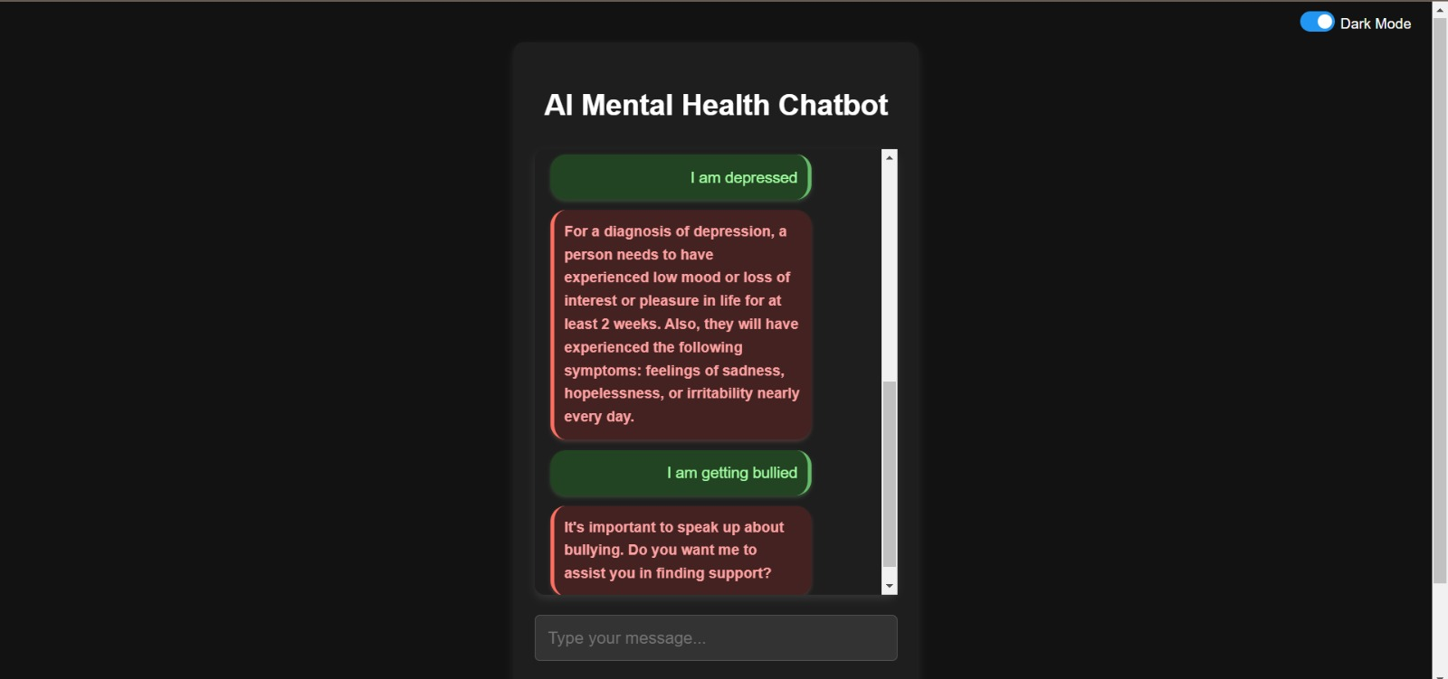
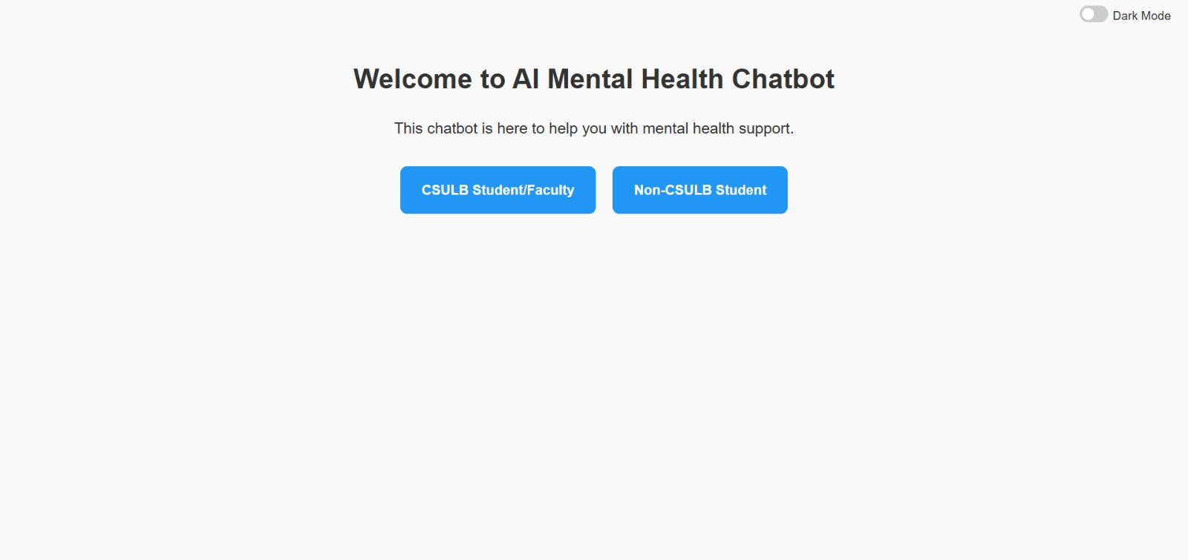
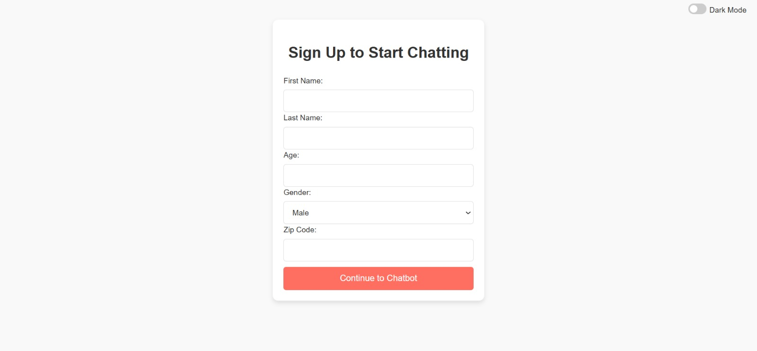
User Module
1
2
3
Personalization:
Uses collected information to provide relevant resources and responses.
Access Control: Users select between:
CSULB Student/Faculty
Non-CSULB Student
Ensures tailored support based on user type.
Sign-Up Form: Collects essential information:
First Name
Last Name
Age
Gender
Zip Code

Slide 8
Live Demo of the AI-Powered Mental Health Chatbot

Slide 9
Technical Architecture
Backend:
Python: Core language for backend logic and integration.
Flask: Manages HTTP routes, form submissions, and frontend-backend communication.
SQLAlchemy: Simplifies database operations for user signups and potential data logging.
NLTK: Processes user inputs using Natural Language Processing for text tokenization and lemmatization.
Keras: Loads and uses a pre-trained deep learning model (model.h5) for chatbot predictions.
JSON: Parses and handles intents and response data for chatbot functionality.
Pickle: Efficiently loads serialized preprocessed data (texts.pkl and labels.pkl) to support fast response times.

Slide 10
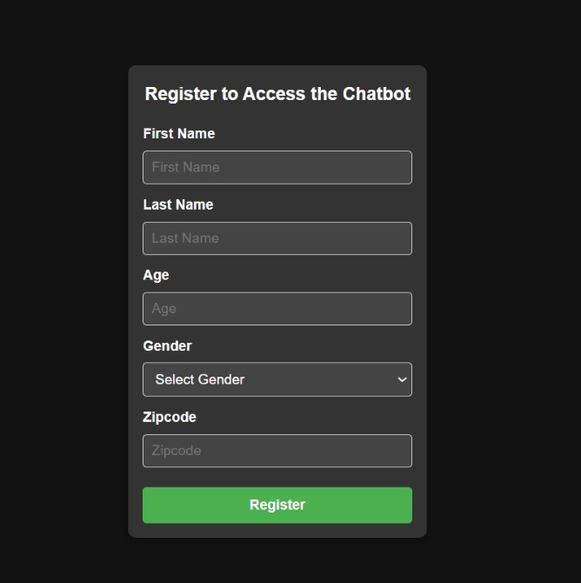
Technical Architecture
Frontend:
HTML: Defines the structure and layout of the chatbot interface, organizing elements like forms, buttons, and text fields for a user-friendly design.
CSS: Enhances the appearance of the chatbot with clean styling, responsive layouts, and consistent visual themes for optimal usability across devices.
JavaScript: Implements dynamic interactions such as real-time user input handling and seamless communication with the backend to deliver a smooth and engaging user experience.

Slide 11
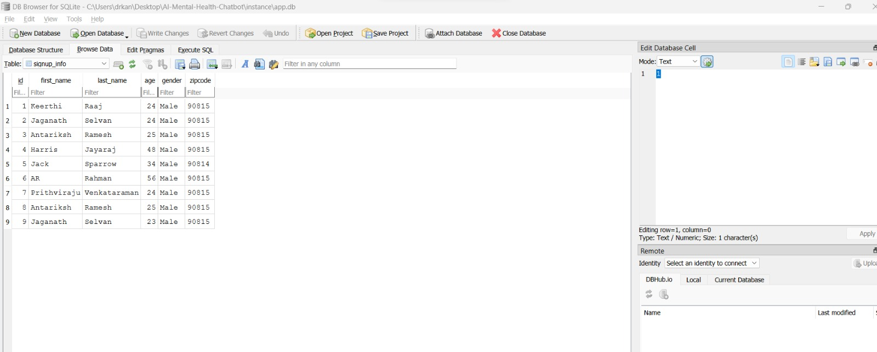
Technical Architecture
SQLite: A lightweight, serverless database designed to store user data, chat sessions, and mood tracking logs efficiently.
Why we switched from MySQL: SQLite was chosen over MySQL due to its simplicity, ease of use, and no need for complex server setup, making it more suitable for development and deployment in this project.

Slide 12
Timeline
1ST HALF
Project Planning Phase
September 17 – October 1
Design Phase
October 2 – October 15
Development Phase
October 16 – November 12
2ND HALF
Testing Phase
November 13 – November 26
Final Review and Adjustments
November 27 – December 3
Project Completion
December 3 – December 10

Slide 13
🧠
📚
Accurate NLP Responses
Personalized Recommendations
Project
Achievements
Chatbot understands and responds empathetically using Natural Language Processing.
Delivers tailored mental health resources based on user inputs and mood analysis.
📊
💻
Comprehensive Mood Tracking
Seamless User Interface
Logs user emotions and visualizes mood trends to support self-awareness.
Intuitive, responsive design for easy and engaging user experience.

Slide 14

Challenges and Insights
Challenges:
TensorFlow and spaCy Compatibility Issues:
Faced initial difficulties with TensorFlow and spaCy during NLP implementation.
Solution: Switched to NLTK for better performance and ease of integration
Insights Gained!
User-Centric Development:
Continuous user feedback was crucial for refining chatbot features.
Tool Flexibility:
Adapting to the right tools ensured smoother development and better outcomes.

Slide 15



Future Work and Enhancements
Collaboration with Mental Health Experts
Partner with professionals to ensure chatbot responses are accurate and effective.
Advanced Emotion Analysis
Improve sentiment analysis to understand and respond to complex emotional states.
Multilingual Support
Expand language capabilities to cater to a diverse user base.

Slide 16

Thank you!

Slide 17



